Slide 1

TNSDC NaanMuthalvan Project
STUDENT NAME: M.Aarthi
REGISTER NO AND NMID: 222410984 and autunm172124
DEPARTMENT: B.sc (Computer science)
COLLEGE: COLLEGE/ UNIVERSITY
Sri Balaji arts and science College / Madras University

Slide 2
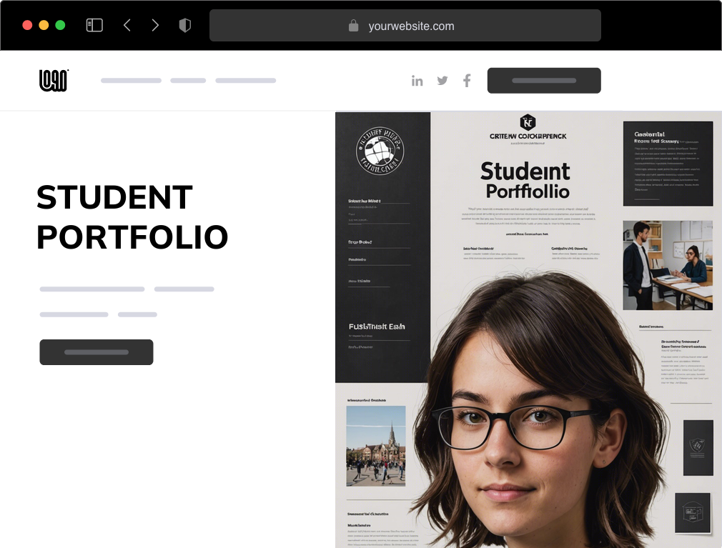



PROJECT TITLE
DIGITAL PORTFOLIO
PLATFORM FOR
STUDENTS AND
PROFESSIONALS..🎗️🪩!!
<<👨🏻‍🎓🌎!!

Slide 3


AGENDA
Problem Statement
Project Overview
End Users
Tools and Technologies
Portfolio design and Layout
Features and Functionality
Results and Screenshots
Conclusion
Github Link
3/21/2024 Annual Review

Slide 4

PROBLEM STATEMENT
In today's digital era, traditional resumes alone are not enough to showcase skills and projects effectively.
Many students and professionals lack a structured online presence to highlight their work.
A digital portfolio provides an interactive and accessible platform to present achievements, skills, and experiences in a professional manner.

Slide 5

PROJECT OVERVIEW
The project focuses on developing a Digital Portfolio Website where students and professionals can present their academic
Achievements,
Projects,
Skills,
Certifications, and work experience.
The portfolio will be visually
Appealing,
user-friendly, and customizable,
Serving as an online professional identity.

Slide 6

WHO ARE THE END USERS?
The End users are Students, Job seekers, Professionals, Institutions.
Students (for placements & higher studies)
Job seekers (to share with recruiters)
Professionals (to showcase career achievements)
Institutions (for maintaining student profiles)

Slide 7

TOOLS AND TECHNIQUES
Frontend, Backend, Database, Version Control, Design Tools
Frontend: HTML, CSS, JavaScript, Bootstrap
Backend: Node.js / Python Flask / PHP (any suitable option)
Database: MySQL / MongoDB
Version Control: Git & GitHub
Design Tools: Canva / Figma

Slide 8


POTFOLIO DESIGN AND LAYOUT
Clean, modern, and responsive Ul.
Sections: About Me, Skills, Education, Projects, Certifications, Contact.
Customizable themes and color schemes.
Mobile-friendly responsive layout.
8

Slide 9
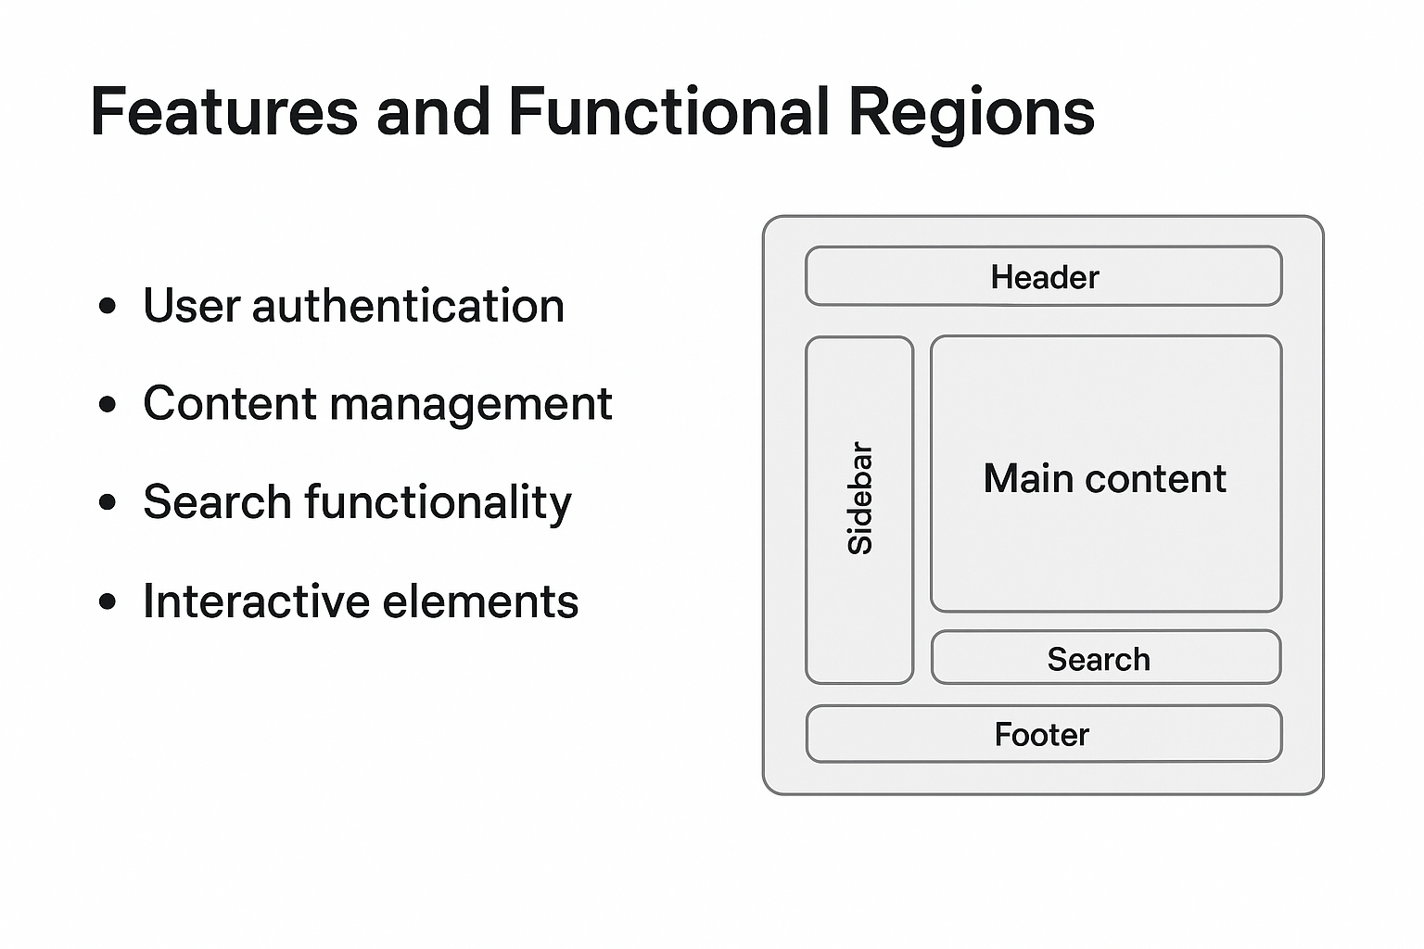
FEATURES AND FUNCTIONALITY
User authentication (Login/Signup)
Upload & manage personal details, resumes, and certificates
Project showcase with links/screenshot
Contact form for networking opportunities
Social media & GitHub integration
Responsive design for all devices

Slide 10
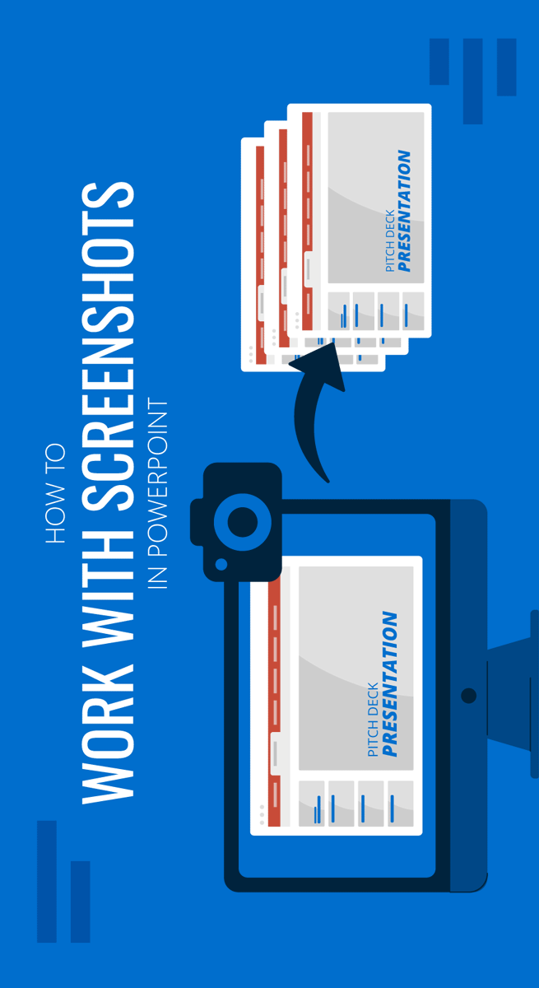
RESULTS AND SCREENSHOTS
The Resale Sand Project proved that sand reselling can be a profitable venture.
By purchasing at wholesale rates and reselling to contractors, a profit margin of 20-25% was achieved.
Market demand is steady due to construction growth.
Main challenge: transportation and government regulations.
Conclusion: The project is financially viable and has long-term potential.
Screenshot Example 1: Profit Graph
Bar graph showing Purchase Cost vs Selling Price vs Profit
Screenshot Example 2: Market Demand Chart
Line chart showing Rising demand for sand in construction
Screenshot Example 3: Business Model Flow
Diagram: Supplier Reseller Contractors/Builders
Screenshot Example 4: Real Usage
Construction site image with sand being used
3/21/2024 Annual Review
10

Slide 11
CONCLUSION
This project successfully creates a platform for students and professionals to present their profiles digitally. It bridges the gap between traditional resumes and modern career requirements by offering an interactive, accessible, and professional online portfolio.
11

